Slide 1


Slide 2
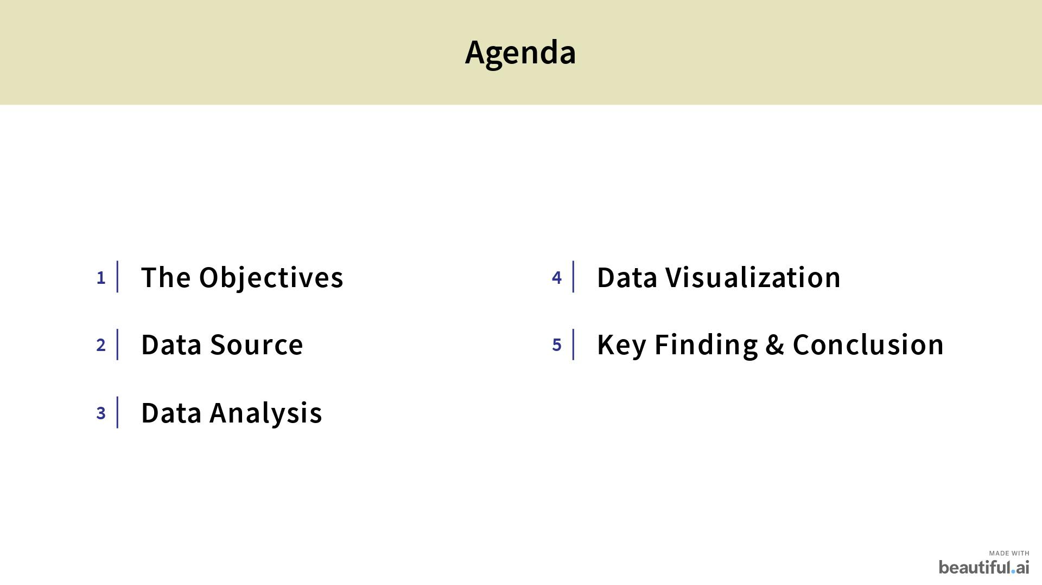

Slide 3
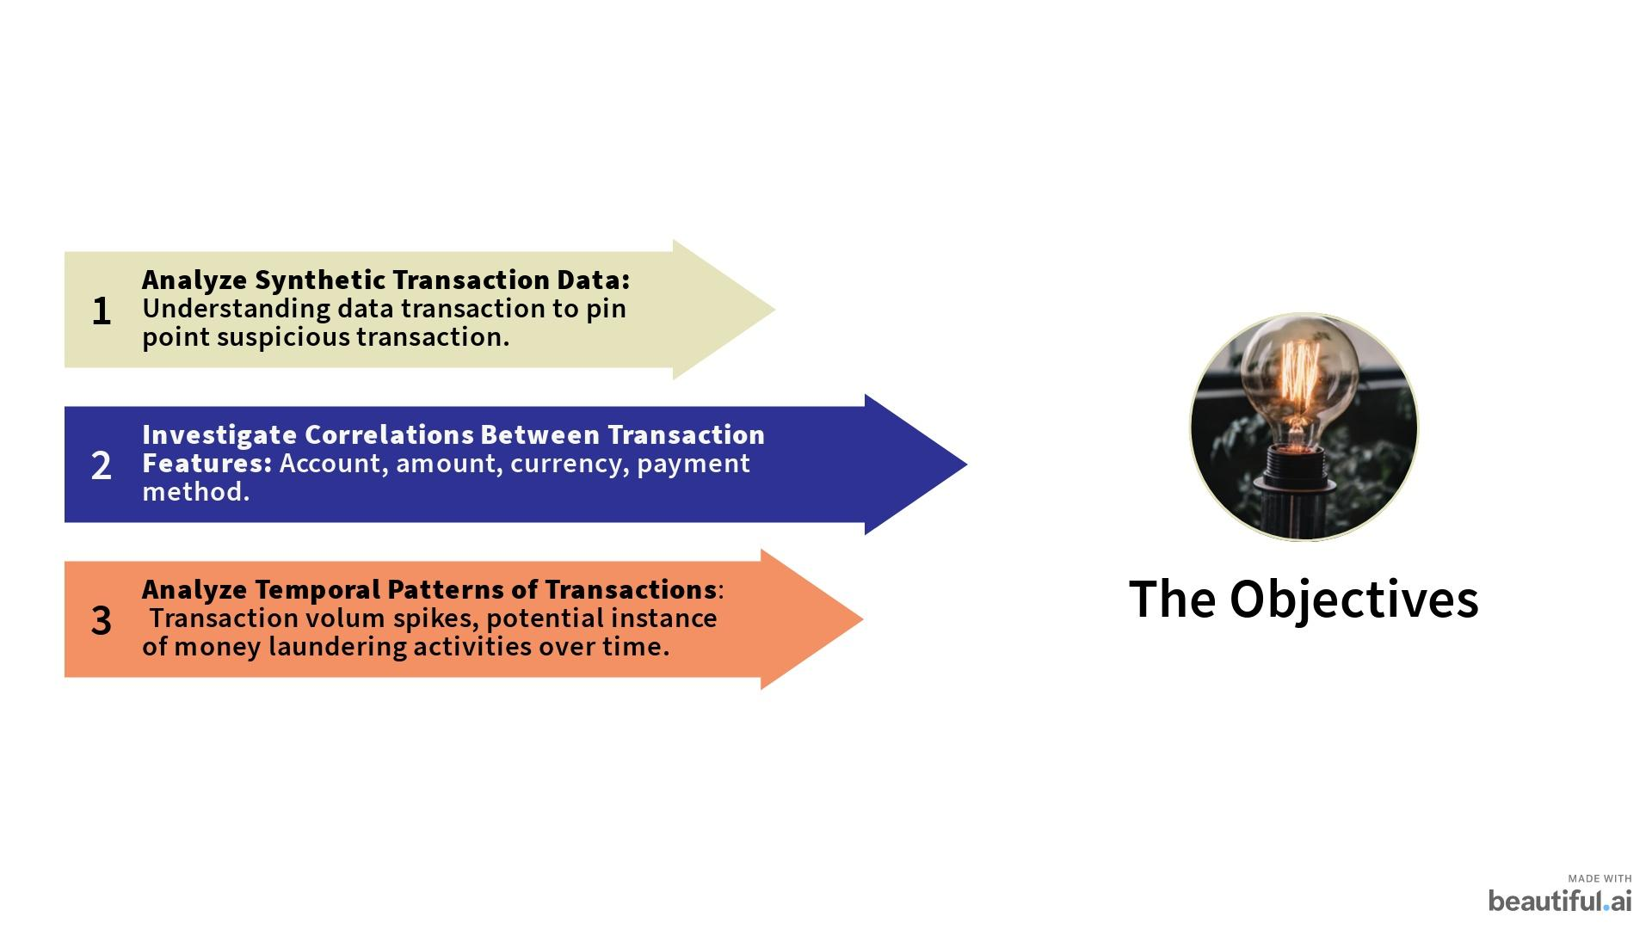

Slide 4
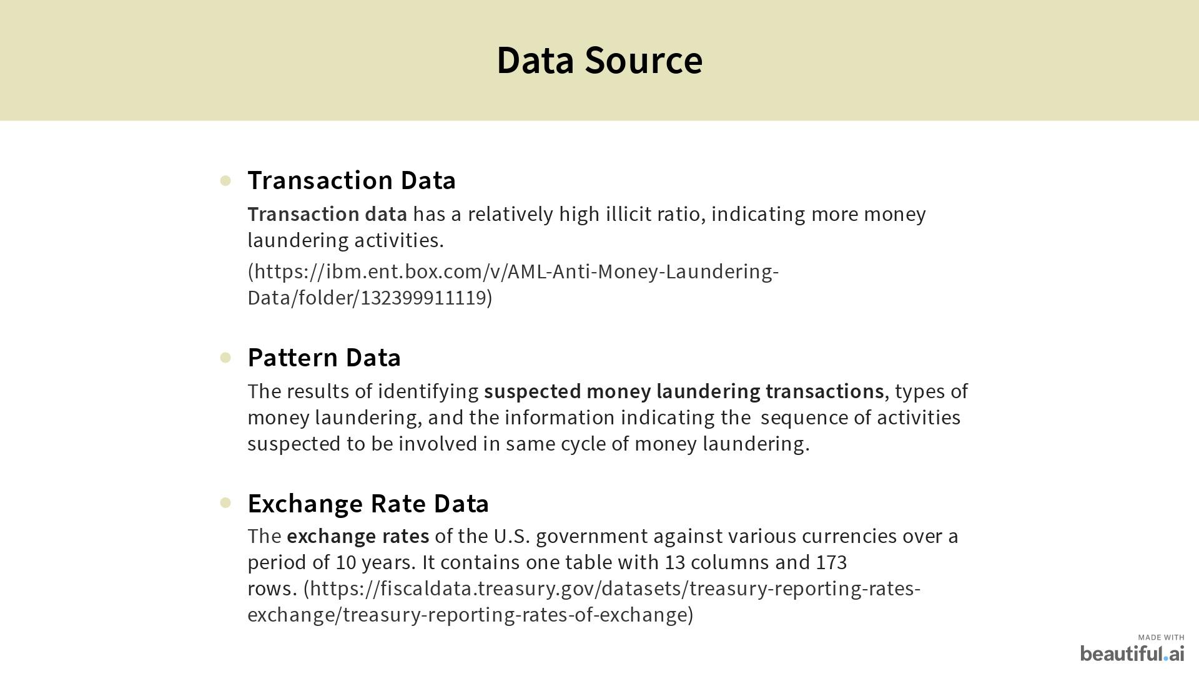

Slide 5
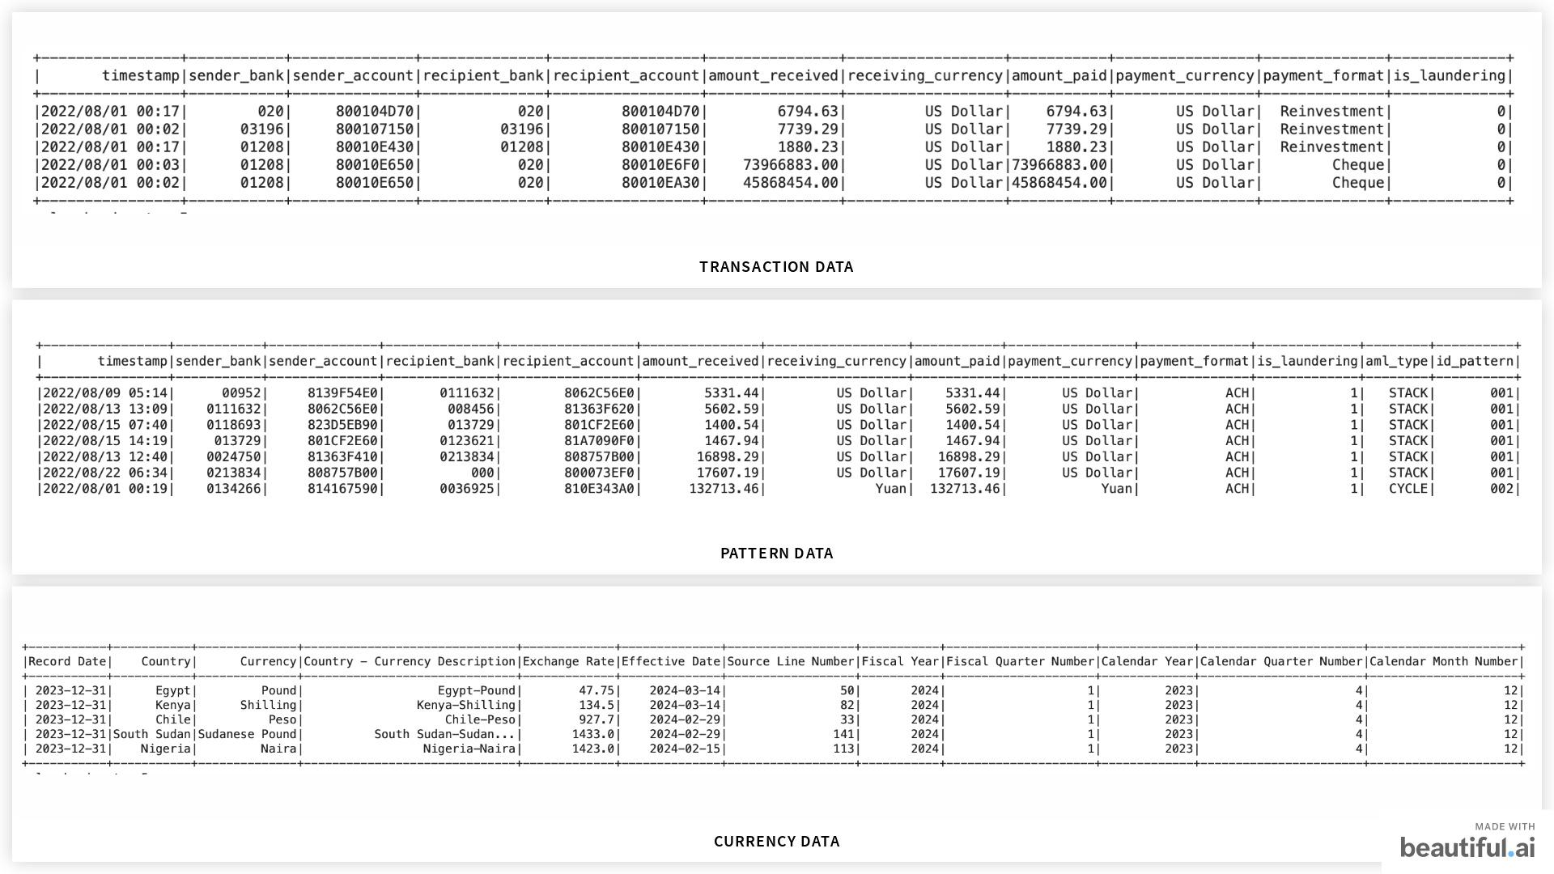

Slide 6
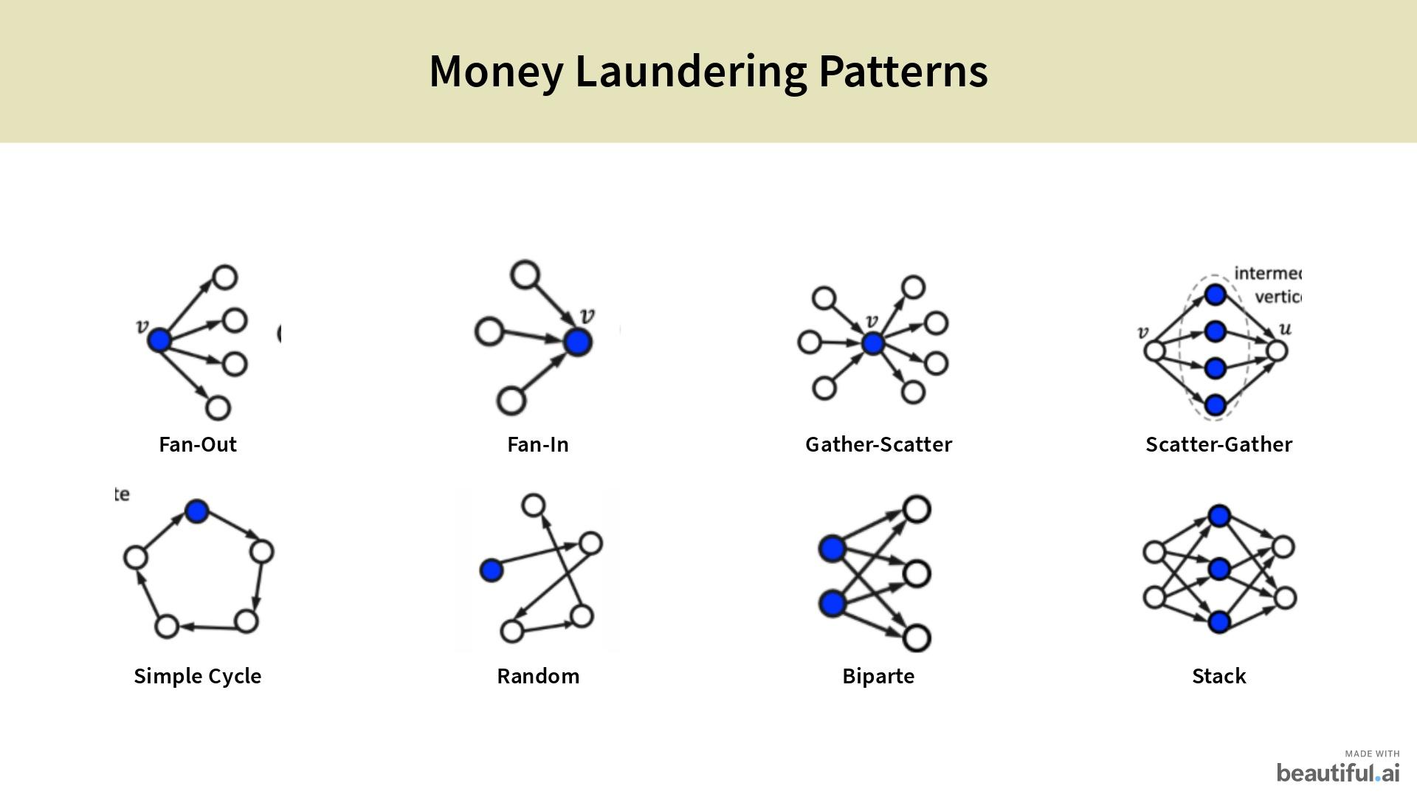

Slide 7
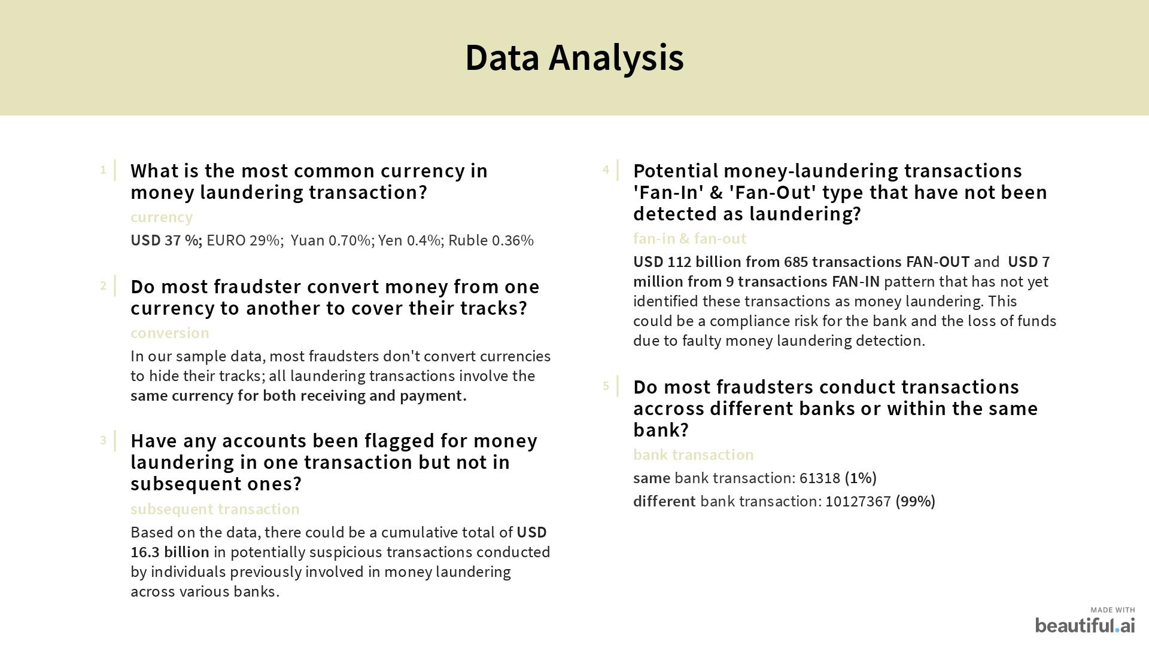

Slide 8
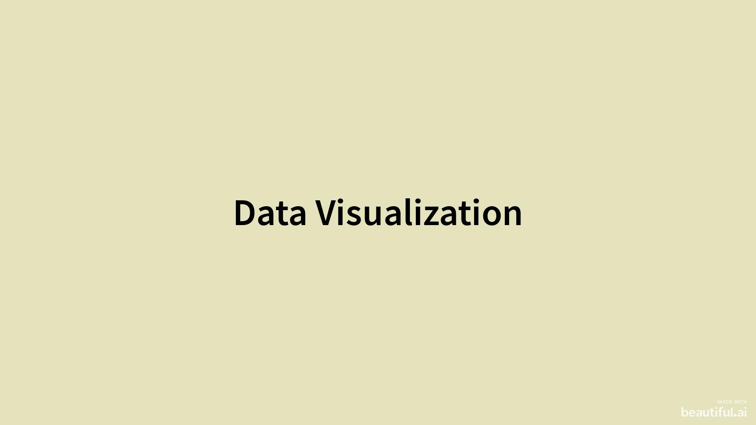

Slide 9
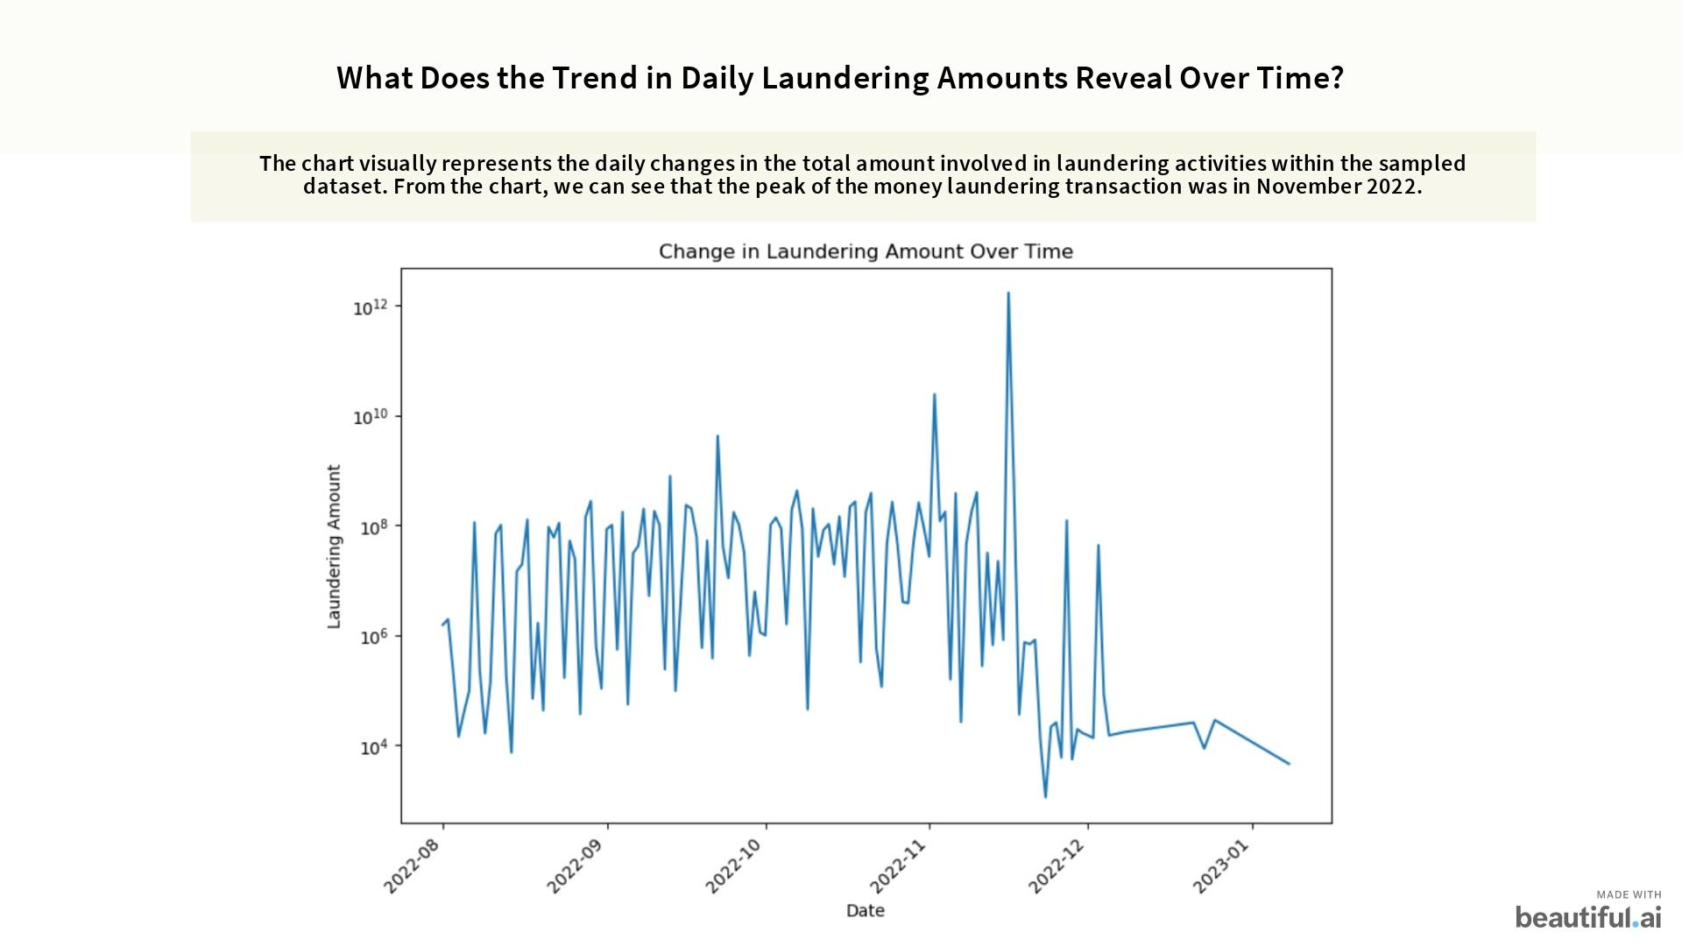
Notes:
This is a plot showing the trends in money laundering activities, we use this graph to provide a visual representation of daily transaction. The dataset illustrates a clear upward trend in the magnitude of transactions, and hits its peak in November 2022. Interestingly, each significant peak is followed by a considerable decline.
The peaks observed may be tied to events that increase money laundering. After each peak, there's a decline, indicating that enforcement measures are likely taking effect, curbing these activities. This pattern suggests a reactive cycle between criminal activity and law enforcement response.

Slide 10
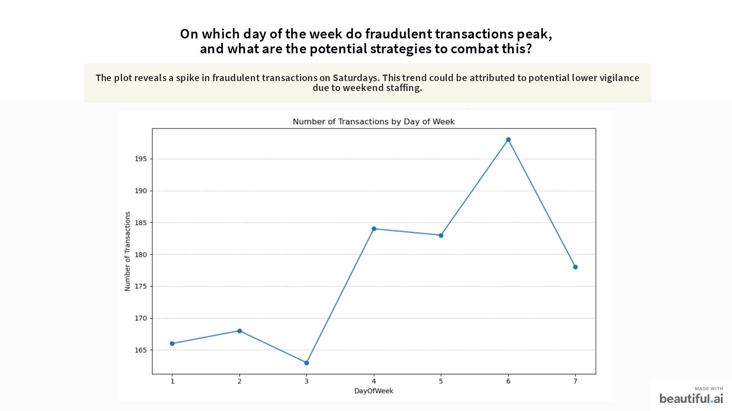
Notes:
This graph presents the number of fraudulent transactions distributed across the days of the week. Notably, there is a distinct spike in fraudulent activities on Saturdays. This pattern may suggest a decrease in vigilance, possibly due to reduced staffing levels over the weekend.

Slide 11
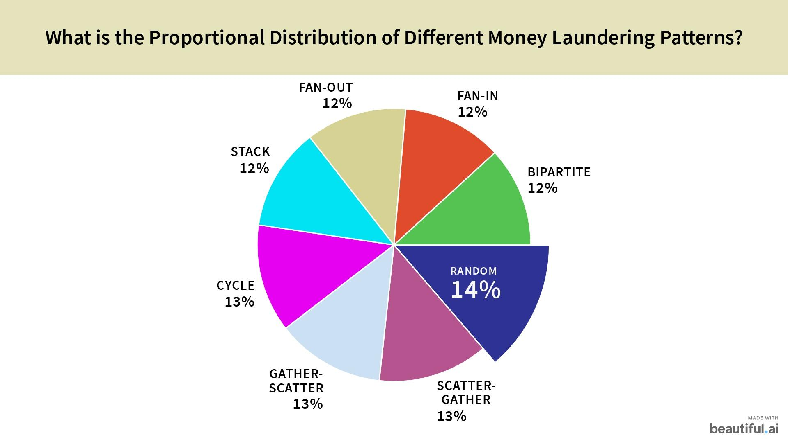
Notes:
The pie chart illustrates the distribution among the eight distinct patterns as introduced by Grace. The proportions are relatively similar, suggesting a diverse mix of tactics employed by launderers. However, we can see that the 'Random' pattern emerges as the most prevalent. This may indicate the intrinsic challenges in detecting and capturing this particular method, as its unpredictable nature can effectively obscure the illicit flow of funds.
Understanding this distribution is critical for developing robust anti-money laundering strategies that are as adaptive and sophisticated as the methods they aim to counter.

Slide 12
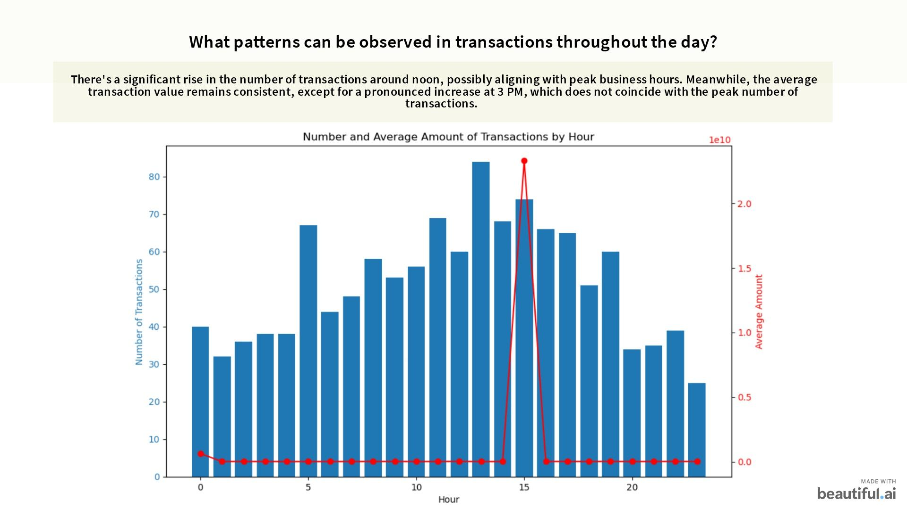

Slide 13
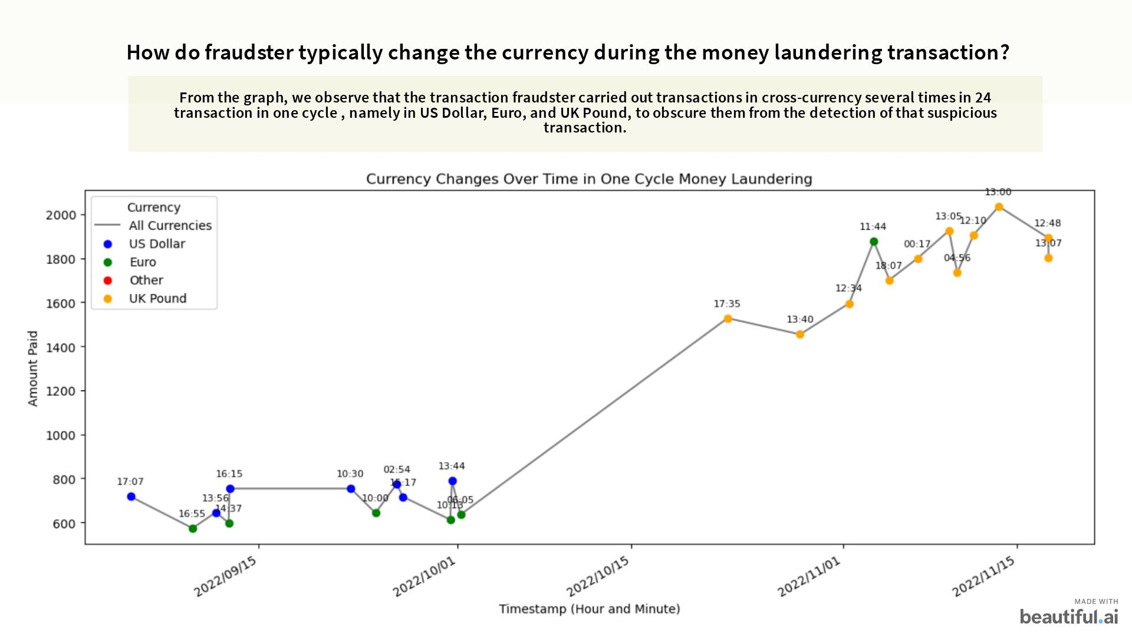

Slide 14
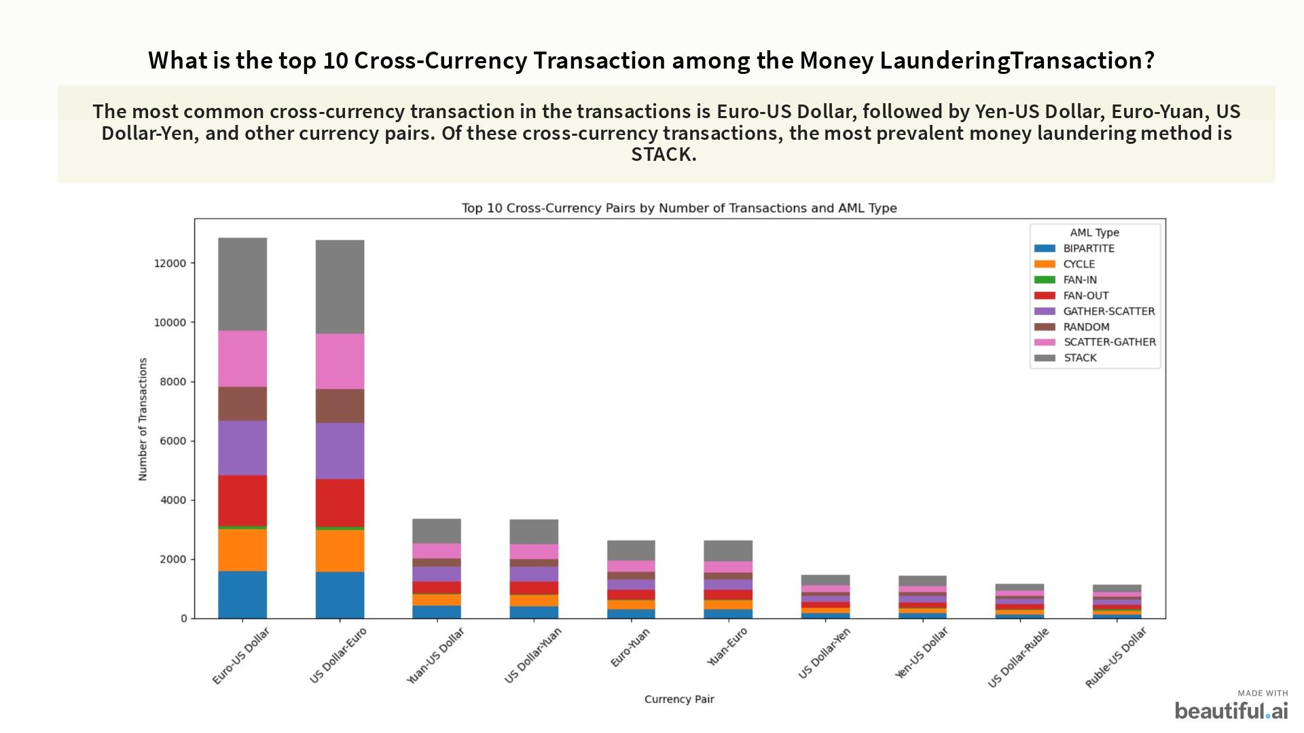

Slide 15
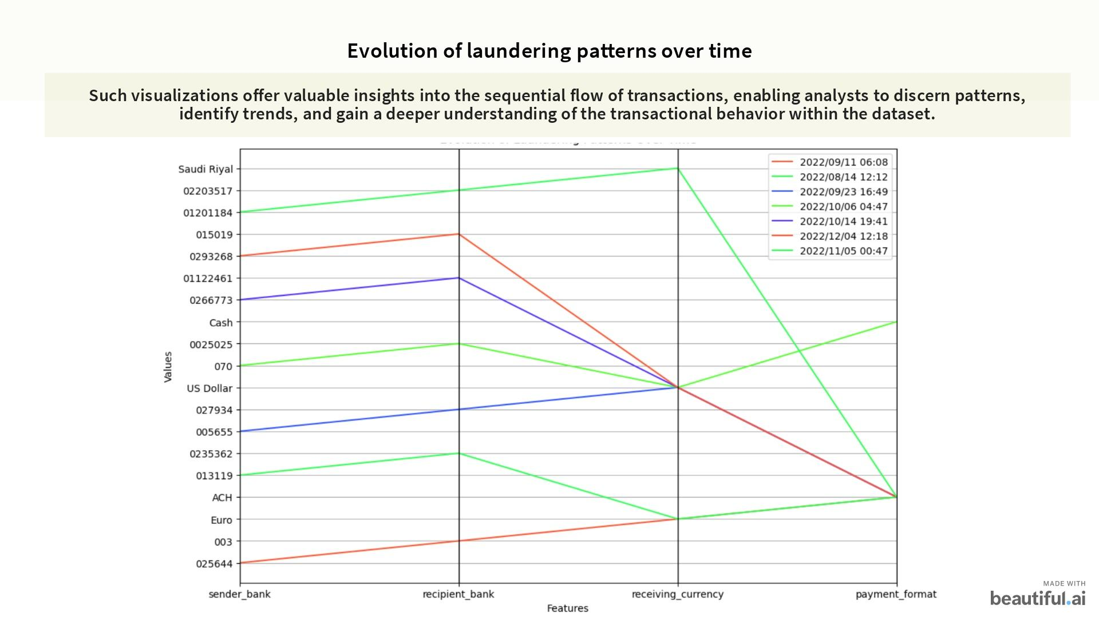
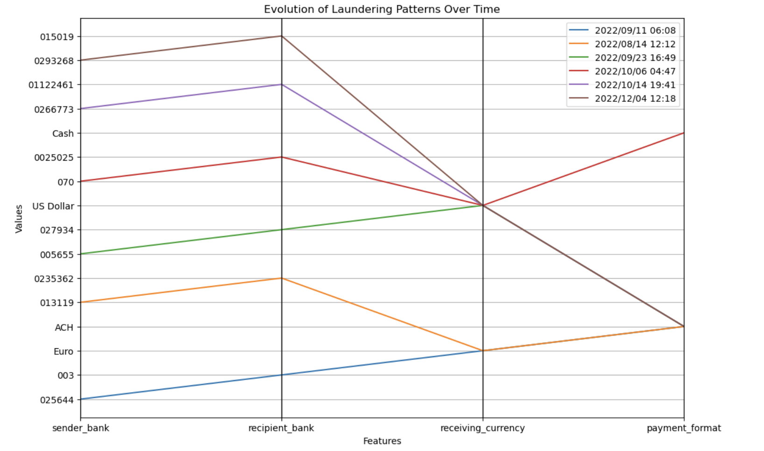

Slide 16
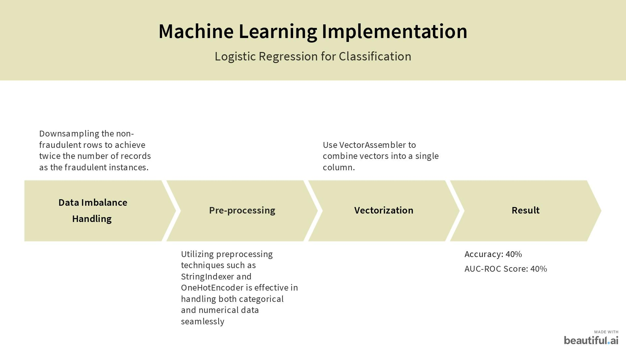

Slide 17
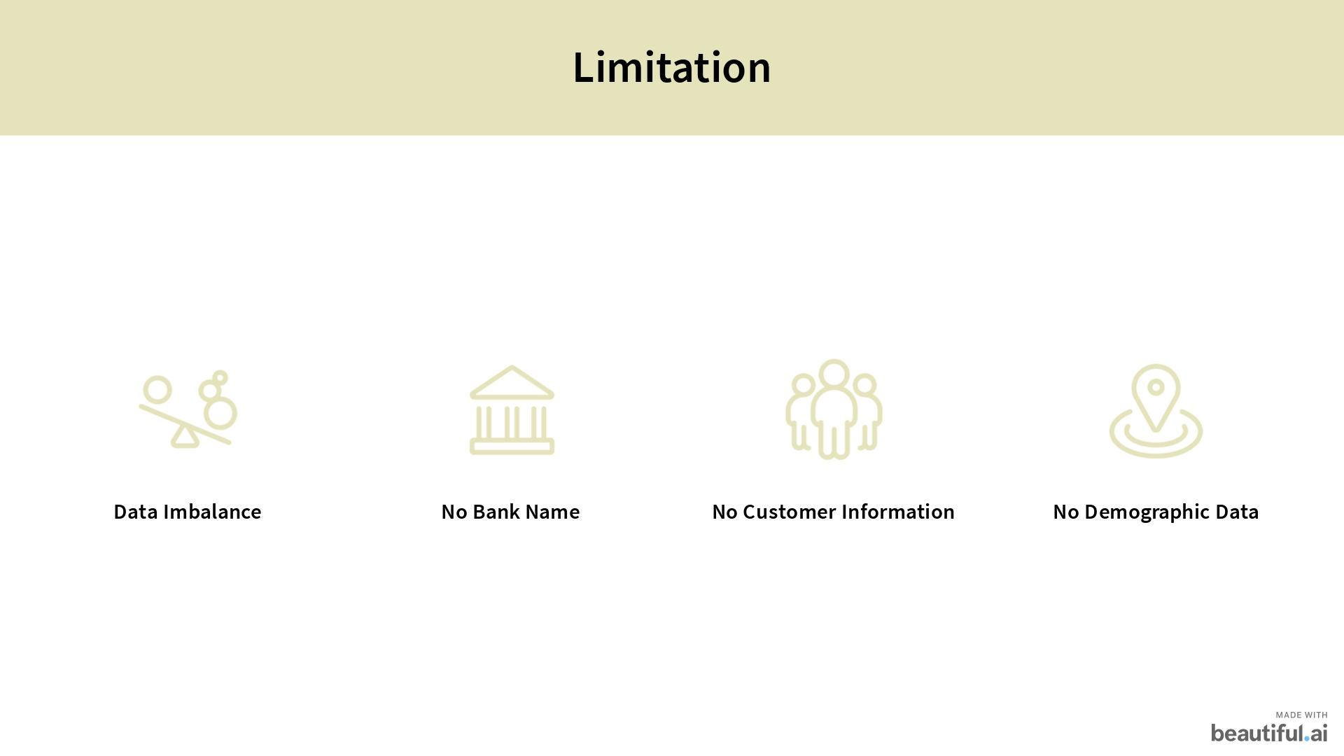

Slide 18
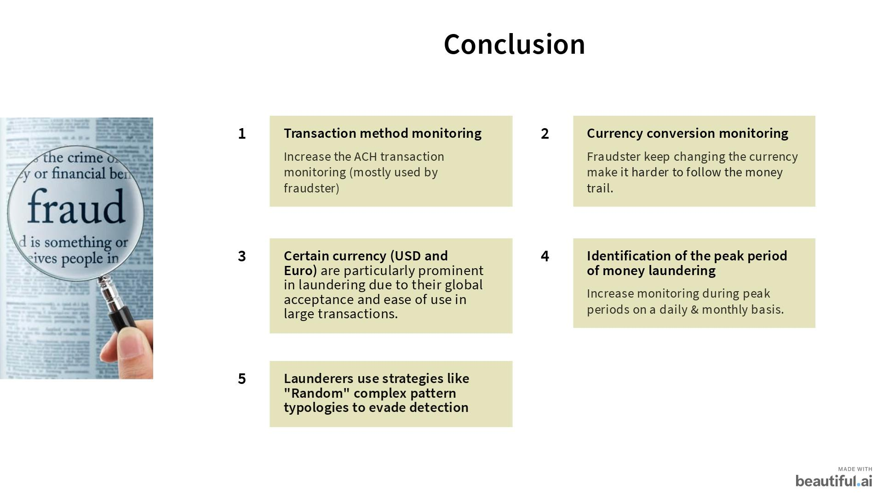

Slide 19
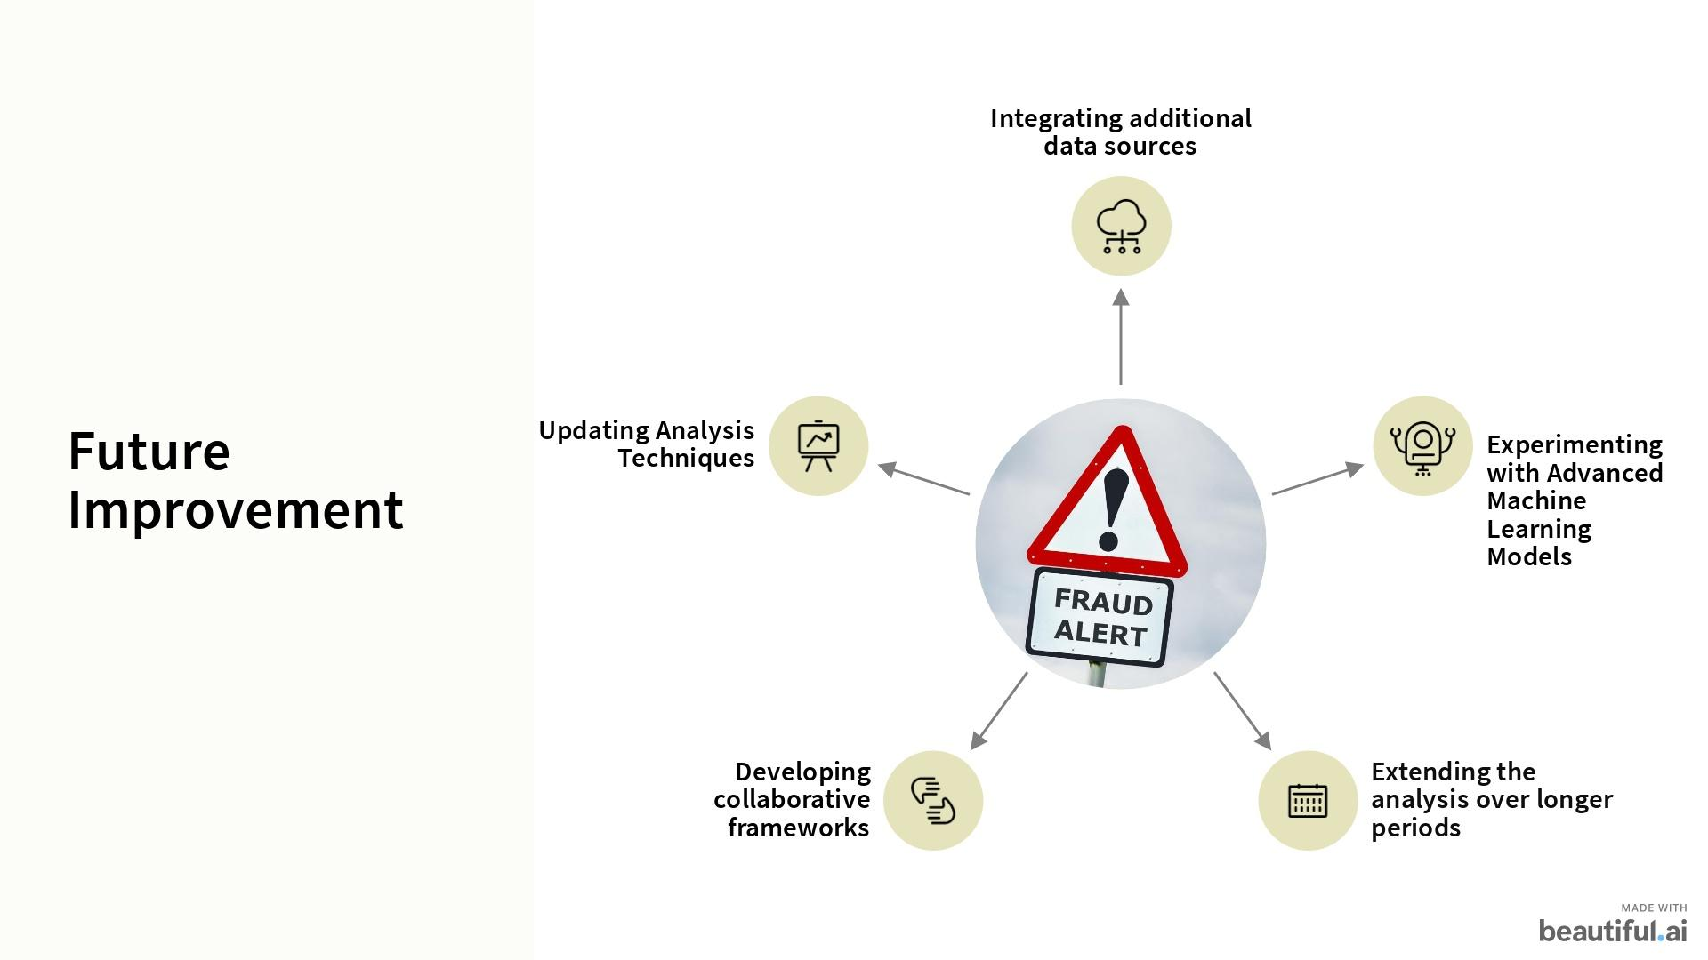

Slide 20


